Slide 1
Cloud cost estimator
B Nandini - 3BR23CS025
Arathi H M - 3BR23CS014
B Deepika - 3BR23CS022
Sanjana D - 3BR21CS141
D R Pallavi - 3BR23CS039

Slide 2
DEFINITIONS :
CLOUD : Cloud is a term used to describe a network of remote servers that are accessed over the internet. It's like renting computing power and storage from a remote data center instead of owning and maintaining your own hardware.
CLOUD COST ESTIMATOR :A cloud cost estimator is a tool that helps you estimate the potential costs of using cloud services. It can be a valuable resource for businesses and individuals who are considering migrating their applications or data to the cloud or simply want to understand the associated expenses.

Slide 3
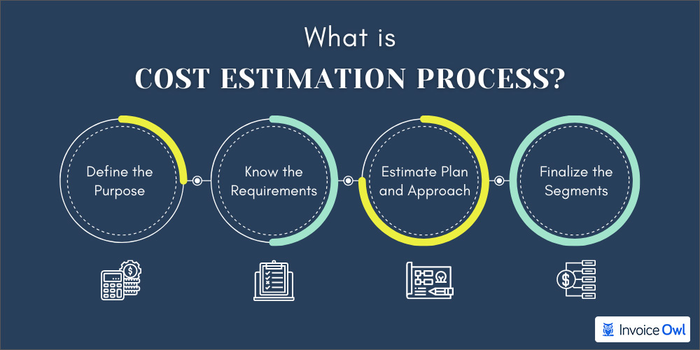

Slide 4
KEY FEATURES :
Core Features
1. Multi-cloud support for AWS, Azure, Google Cloud, and more.
2. Resource-based estimation for accurate cost calculation.
3. Real-time pricing data integration.
4. Cost comparison across providers and regions.
5. Customizable cost models.
Estimation Features:
1. Instance estimation for virtual machines and containers.
2. Storage estimation for object, block, and file storage.
3. Database estimation for relational and NoSQL databases.
4. Networking estimation for data transfer and load balancing.

Slide 5
Importance of cloud cost estimation :
Understanding cloud costs helps organizations optimize their cloud usage.
Effective cost management can lead to significant savings over time.
Cloud providers often have complex pricing models that require careful analysis.
Cloud pricing models can include pay-as-you-go, reserved instances, and spot pricing.
Each model has different implications for cost estimation and budgeting.
Familiarity with these models is essential for accurate cost forecasting.

Slide 6
Comparision b/w old & new version
Old version
New version
Static pricing models
Basic user interfaces
Lack of integration
No optimization suggestions
Single cloud focus
Dynamic pricing models
User friendly interfaces
Integration with real-time data
Cost optimization recommendations
Multi cloud support

Slide 7
Challenges in cost estimation :
Cloud pricing models can include pay-as-you-go, reserved instances, and spot pricing.
Each model has different implications for cost estimation and budgeting.
Familiarity with these models is essential for accurate cost forecasting.
Frequent price changes and regional price variations

Slide 8
Future trends in cloud cost estimation
Automation and AI are increasingly being integrated into cost estimation processes.
Predictive analytics will play a larger role in shaping future cloud budgeting.
As cloud services evolve, so too will the strategies for effective cost estimation
The future of cloud computing is marked by increasing adoption of hybrid and multi-cloud environments , greater emphasis on cloud security , AI and machine learning

Slide 9
Real world case studies
Several organizations have successfully implemented Python for cost estimation.
Case studies reveal common challenges and best practices in cloud cost management.
Learning from these examples can guide your own implementation efforts.
Cloud computing allows for processing and analysis of large datasets enabeling businesses to gain insites and make data driven decisions.

Slide 10
conclusion
The cloud cost estimator project successfully developed a tool that accurately predicts cloud infrastructure costs based on various input parameters. By providing users with reliable cost estimates, the tool empowers them to make informed decisions about their cloud deployments, optimize resource utilization, and effectively manage their cloud budgets.

Slide 11
THANK YOU

